Slide 1

Fans are cooler than you thought
Luke Meiler
Austin Marga

Slide 2
Introduction
What is the line frequency and why should I care?

Slide 3
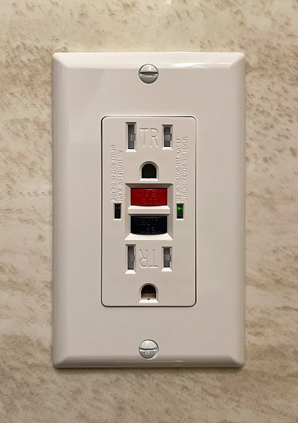
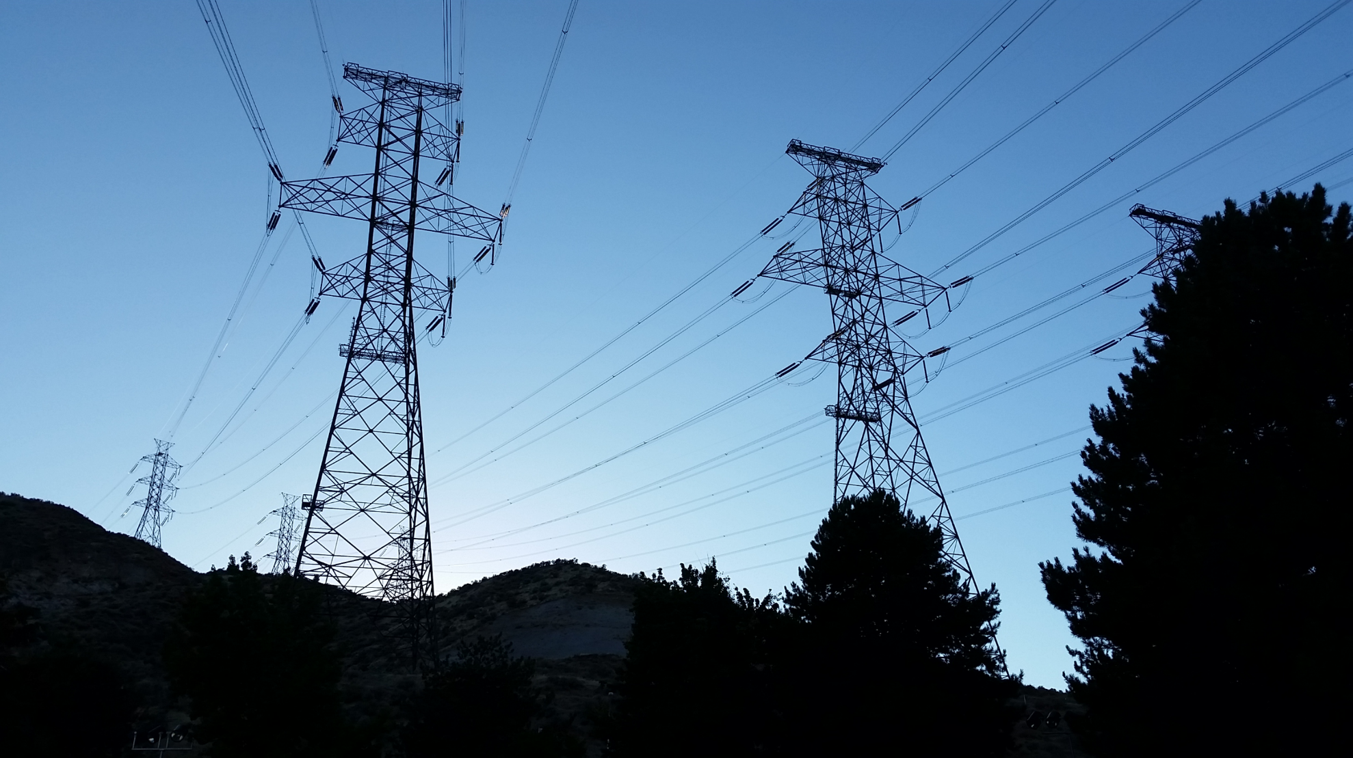
What is the Line Frequency?
Ben Kurtovic, CC BY-SA 4.0 <https://creativecommons.org/licenses/by-sa/4.0>, via Wikimedia Commons
Varistor60, CC BY-SA 4.0 <https://creativecommons.org/licenses/by-sa/4.0>, via Wikimedia Commons

Slide 4
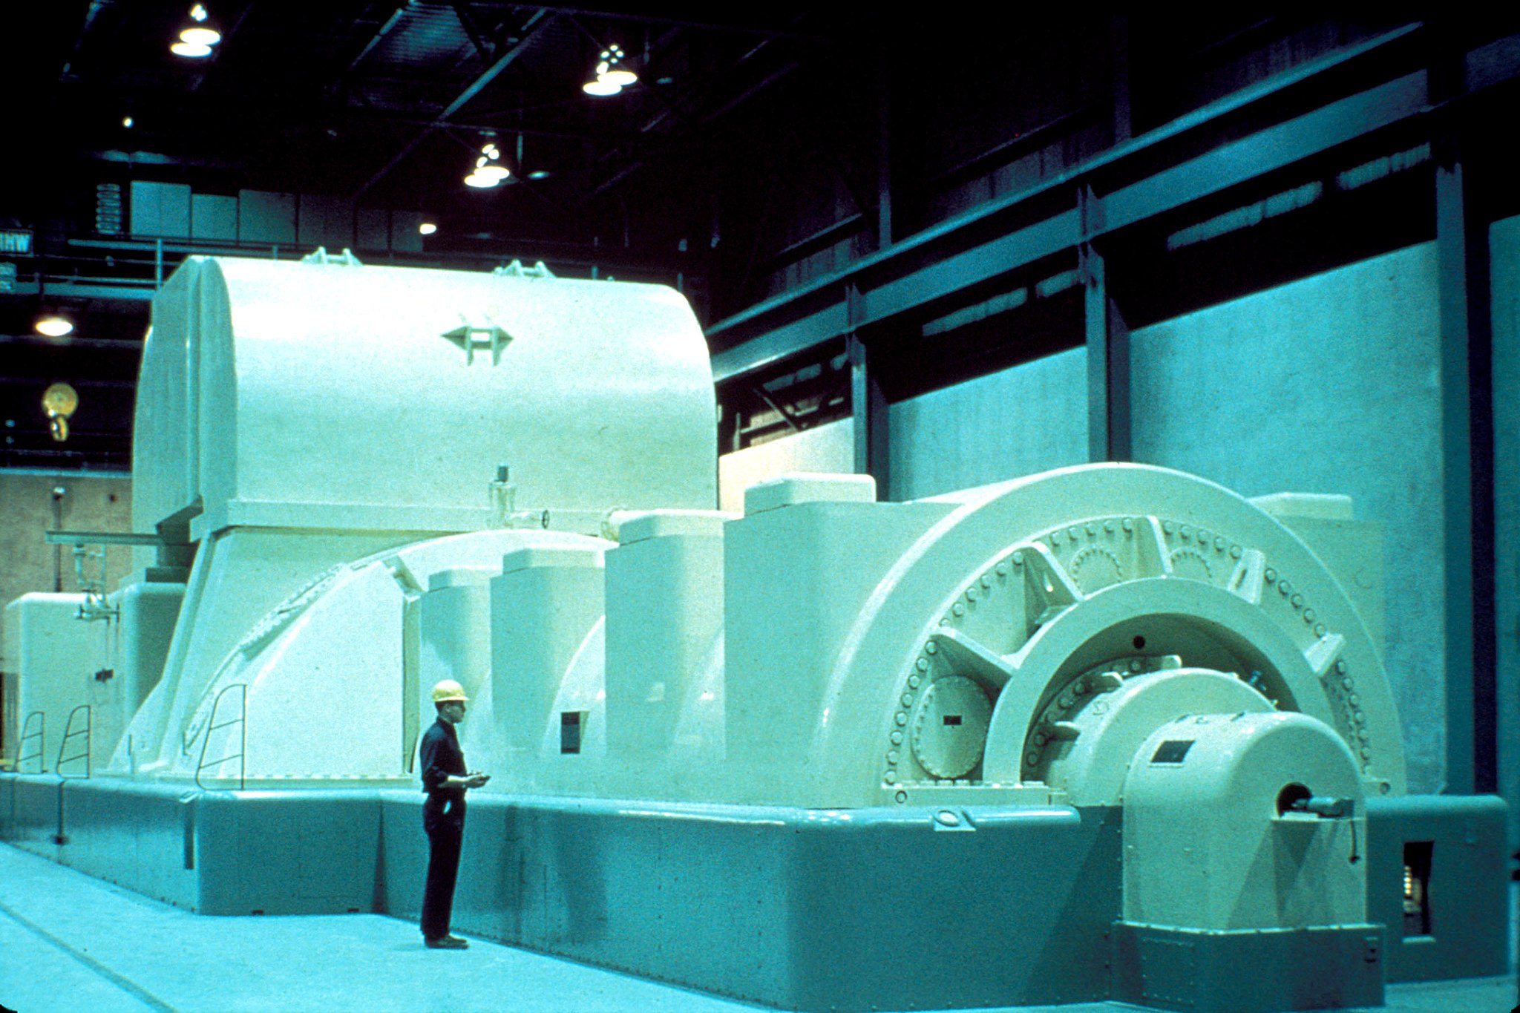
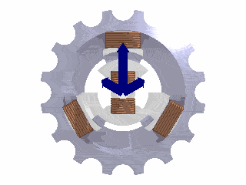
Where does it come from?
User: Mtodorov_69, CC BY-SA 3.0 <http://creativecommons.org/licenses/by-sa/3.0/>, via Wikimedia Commons
NRC, Public domain, via Wikimedia Commons

Slide 5
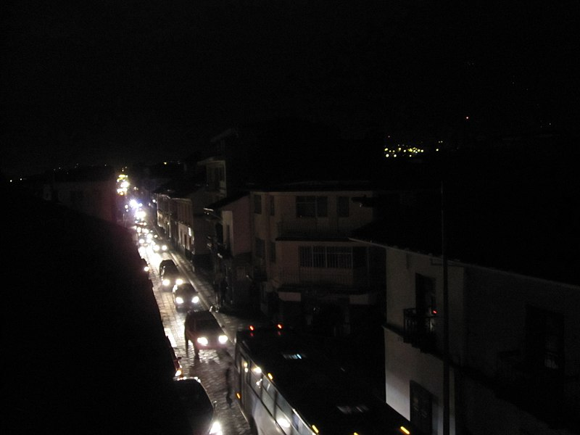
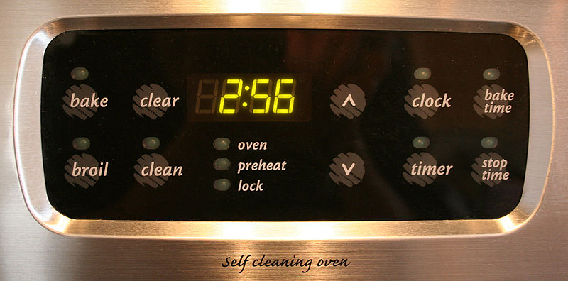
Why does it matter?
Tysto, Public domain, via Wikimedia Commons
Jen, CC BY-SA 3.0 <https://creativecommons.org/licenses/by-sa/3.0>, via Wikimedia Commons

Slide 6
The Experiment
What did we do and how does it work?

Slide 7
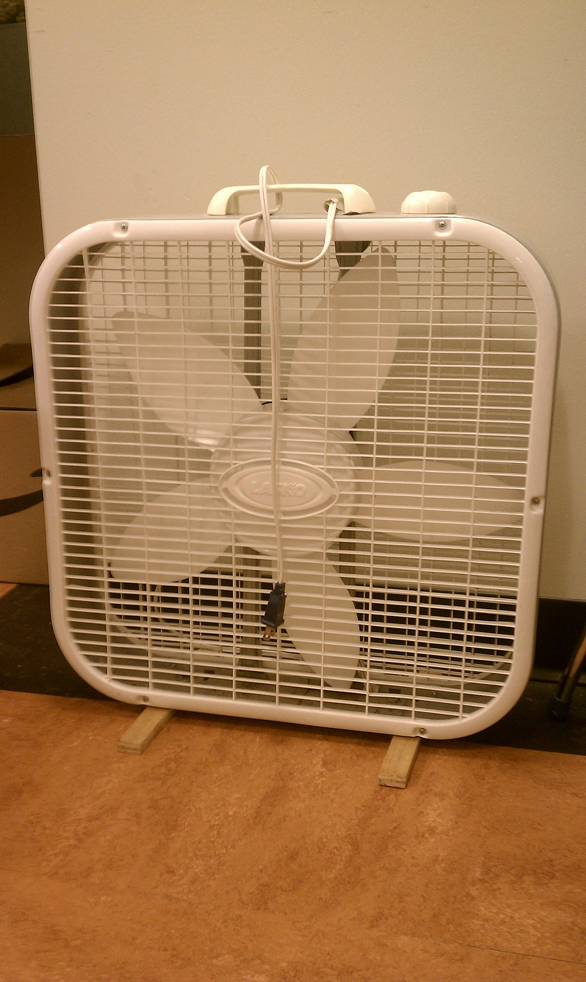
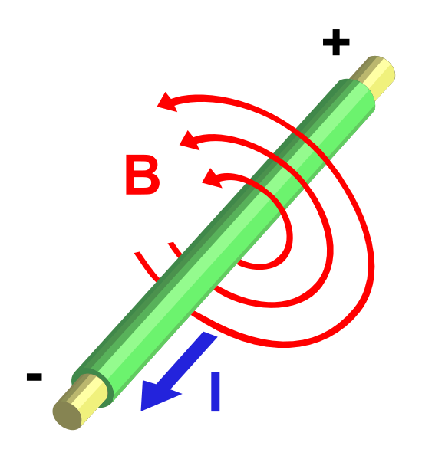
Arbitrarily0, CC BY-SA 3.0 <https://creativecommons.org/licenses/by-sa/3.0>, via Wikimedia Commons
User:Stannered, CC BY-SA 3.0 <http://creativecommons.org/licenses/by-sa/3.0/>, via Wikimedia Commons

Slide 8
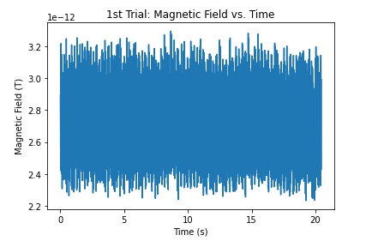
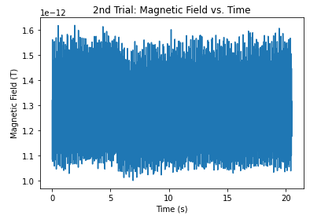
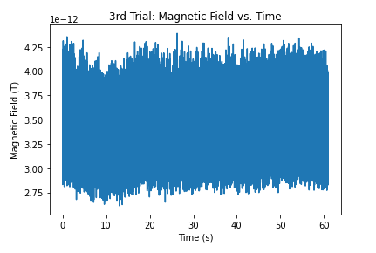
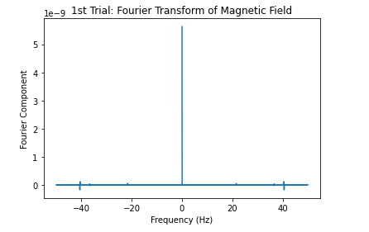
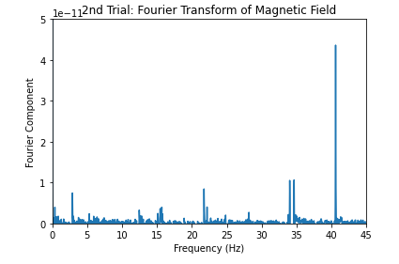
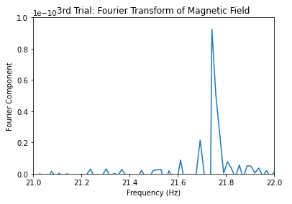

Slide 9
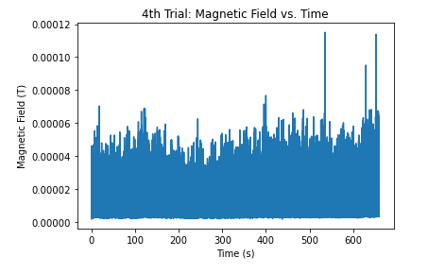
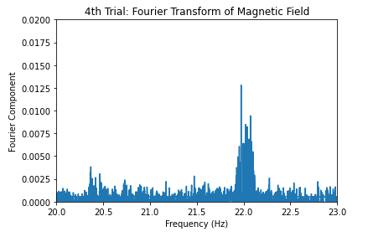
The time series and FFT more anticipated than Elder Scrolls 6

Slide 10
Results and conclusions
What did we learn from all of this?

Slide 11

Recap:
Covered what the line frequency is
Talked about where it comes from
Discussed why it is important
Appliances that use it
Relation to power blackouts
Explained our experiment and some of the physics behind it
Showed our initial time series and FFT plots and motivated each step in the process that we went through.
Lastly, we reached a stable frequency in our final plot which shows what we were trying to find.
https://github.com/ubsuny/CP1_LineFrequency_Project

